Slide 1
Comparisons

Slide 2
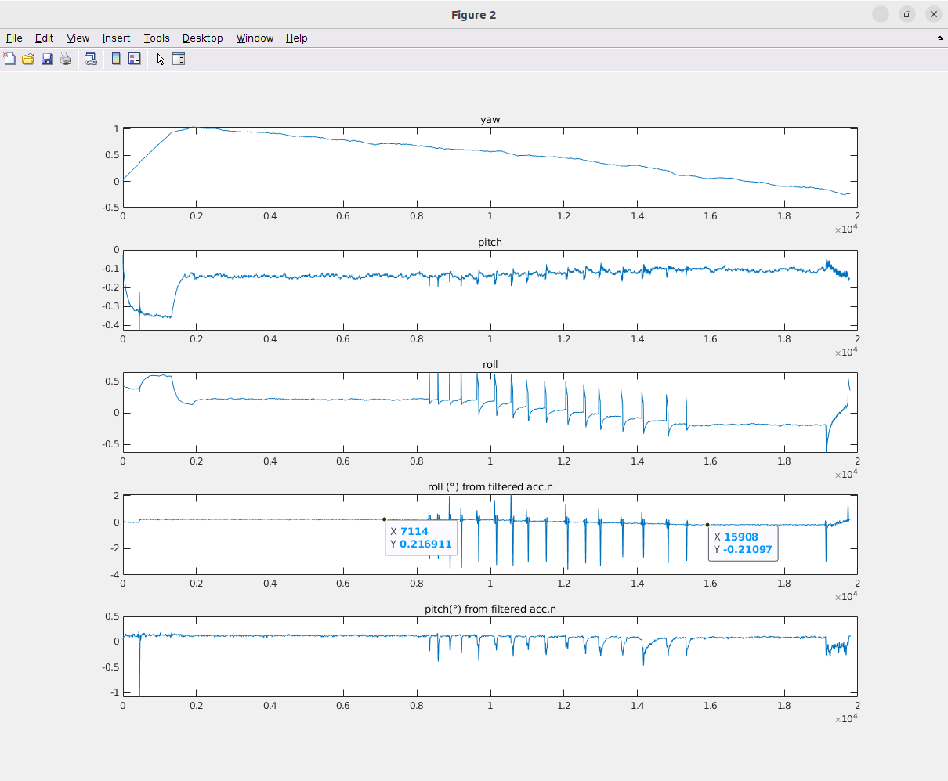
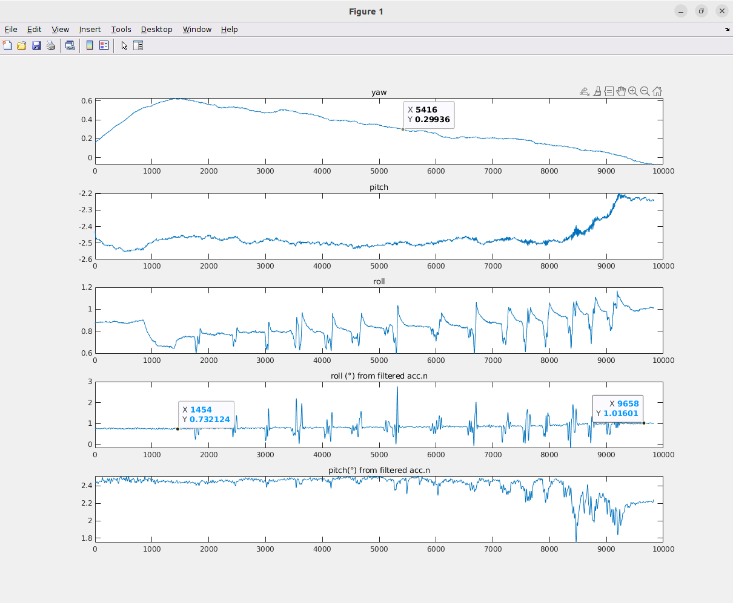
No weight
Previous data (≈ 0.4° variation) Lab measured data (≈ 0.3° variation)

Slide 3
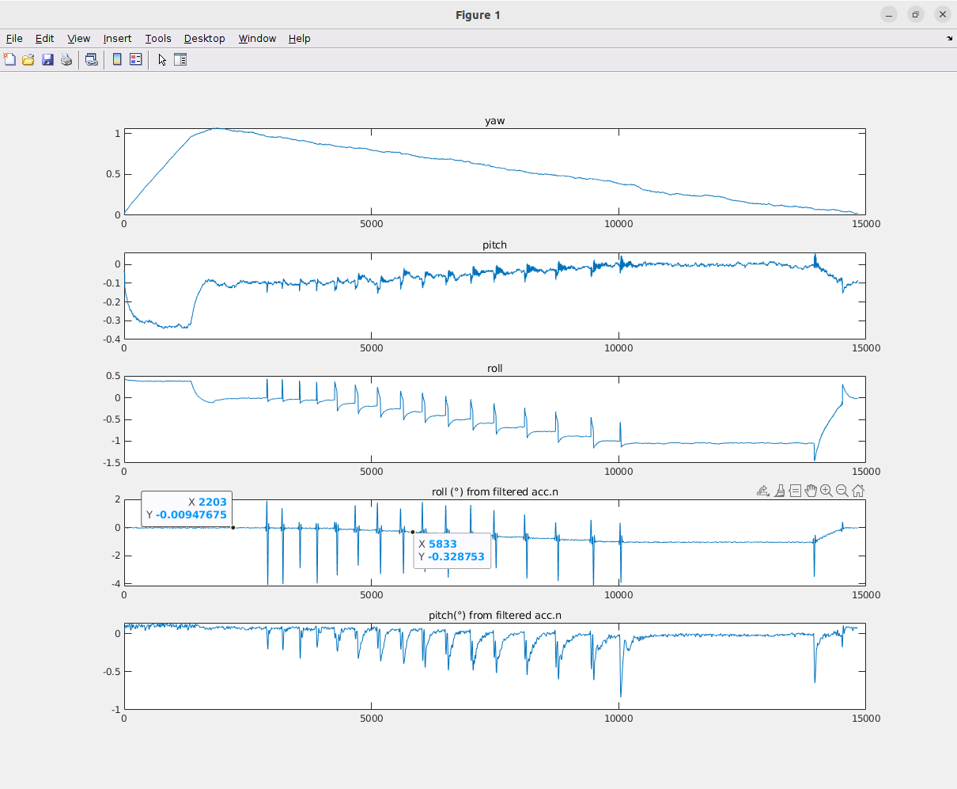
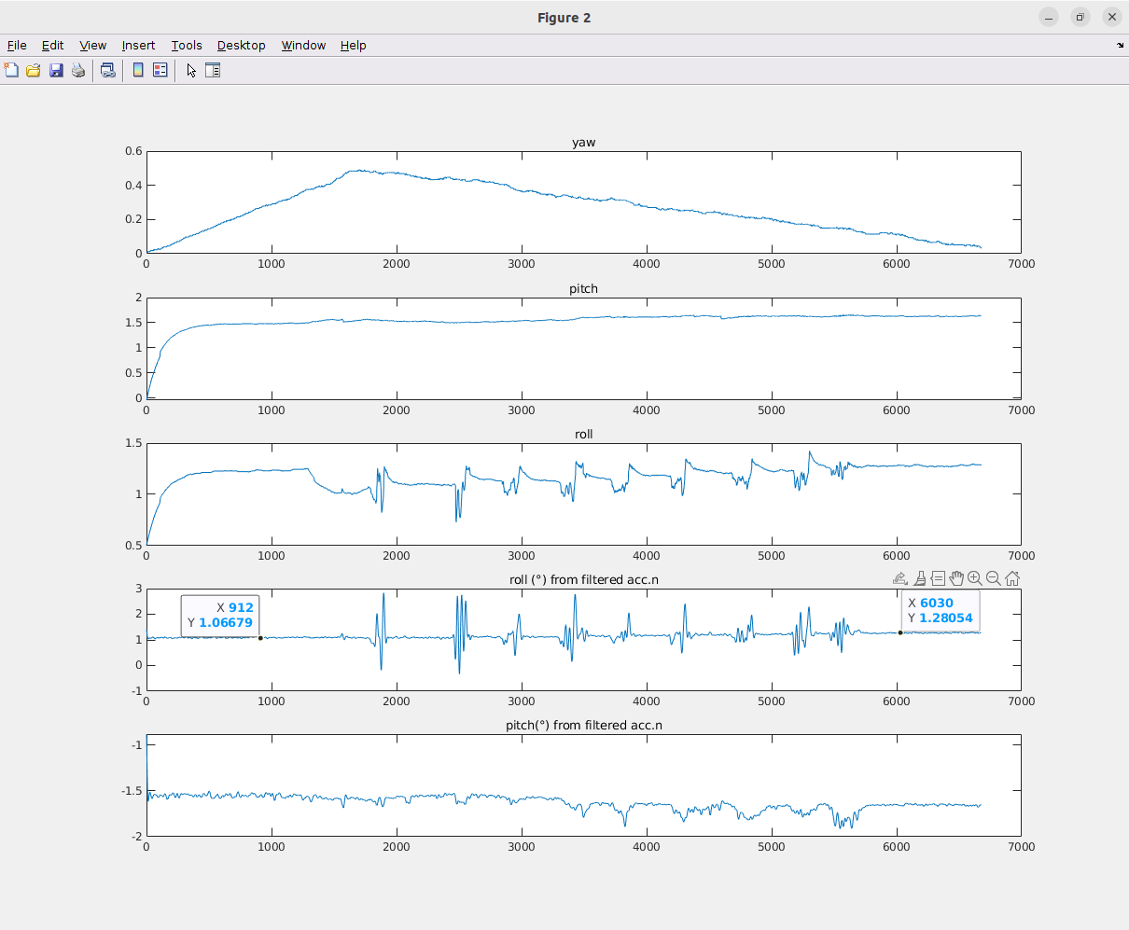
31 KG Weight
Previous data (≈ 0.3° variation) Lab measured data (≈ 0.2° variation)

